Slide 1
Good and Bad Fruit
Matthew 12:33-37

Slide 2
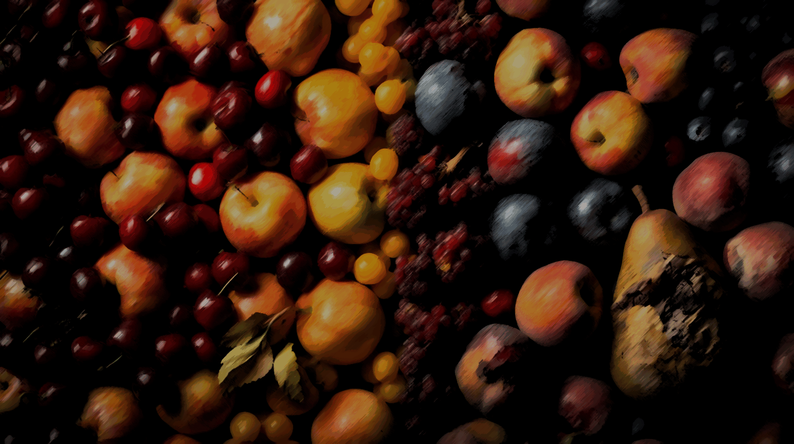
Our Text
A Tree is Known is By Its Fruit (33)
Evil Men and Good Men
James 1:26; Psalm 19:12
The Heart (Speech and Other Things)
Matthew 15:17-20
The Judgment of God (37)
1 Timothy 1:18-20

Slide 3
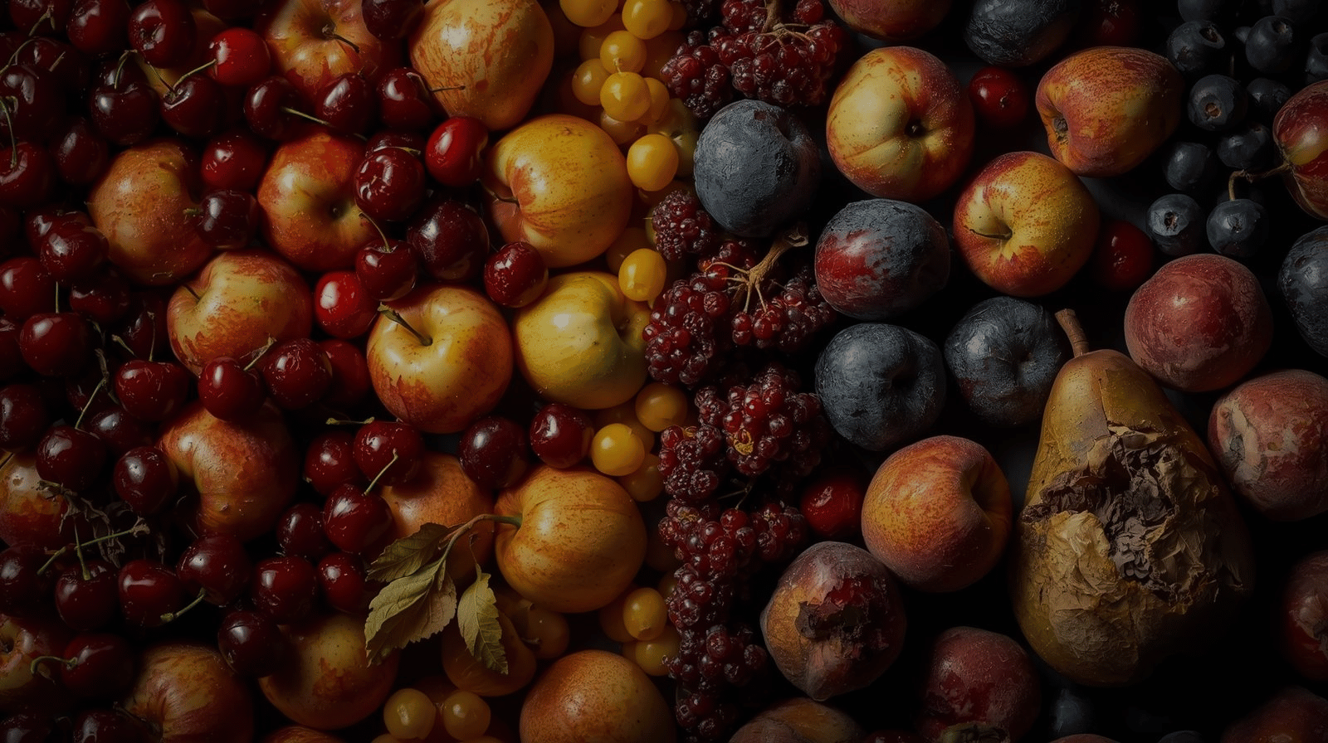
Conclusion
James 3:6
Our speech has great importance in pleasing God
May our hearts be pure in the sight of our God

